Slide 1


K.RAMAKRISHNAN COLLEGE OF TECHNOLOGY (AUTONOMOUS), TRICHY
MEDICATION REMINDER SYSTEM
PRESENTED BY
MOHAMED RAFI M- 2303811714821017

Slide 2
ABSTRACT
The Medication Reminder System is designed to help individuals take their medications on time through automated alerts and notifications.
It ensures proper medication adherence by storing user schedules and sending timely reminders.
The system uses a relational database to manage user information, medication details, and reminder logs

Slide 3
INTRODUCTION ABOUT PROJECT
The Medication Reminder System helps individuals take their medications on time through automated alerts.
It ensures proper medication adherence by tracking dosage schedules and notifying users.
The system is beneficial for elderly patients, individuals with chronic conditions, and busy professionals who may forget their medications.
It reduces human dependency by providing a digital solution for medication tracking.

Slide 4
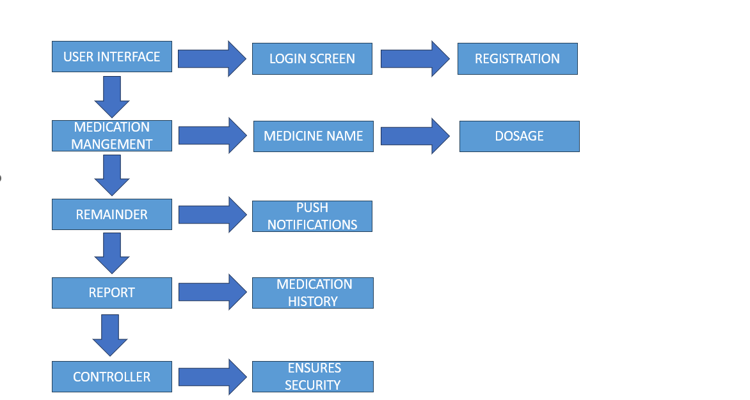
PROPOSED ARCHITECTURE

Slide 5
PROPOSED EXPLANATION ADVANTAGE
A user-friendly application where users can register, add medications, and set reminders based on dosage schedules.
A database-driven system that stores user data, medication details, and logs reminder notifications efficiently.
Provides real-time alerts and logs missed doses, allowing users to track their medication intake history.
Supports multiple notification methods, including if possible by sms or push notifications, ensuring accessibility.

Slide 6
MODULES OF PROJECTS
User Management Module: Handles user registration, login, and profile management.
Medication Management Module: Allows users to input medicine name, dosage, and frequency.
Reminder Module: Sends scheduled notifications via SMS, email, or push notifications.
Report Module: Tracks medication history and missed doses for health monitoring.
Security Module: Ensures data protection, encryption, and user authentication.

Slide 7
ADVANTAGES
Prevents missed doses by providing timely alerts and reminders.
Improves health outcomes by ensuring proper medication adherence without human dependency.
Reduces caregiver burden by automating the reminder process for elderly or dependent users.
Enhances medical record management by digitally storing and organizing medication history.

Slide 8
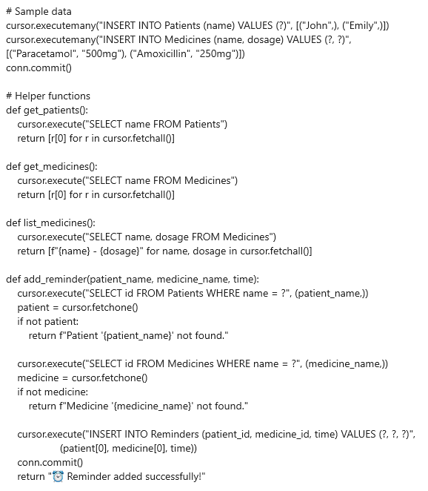
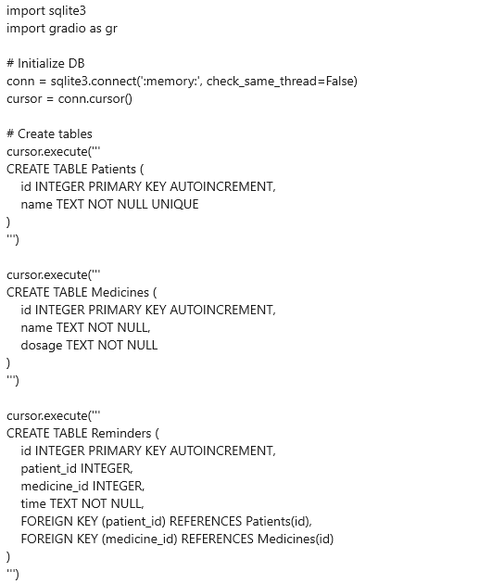
SOURCE CODE

Slide 9
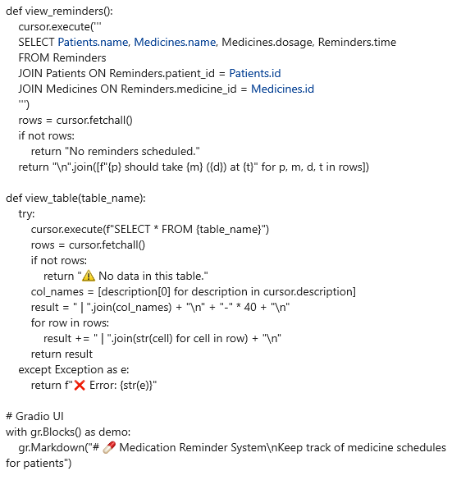
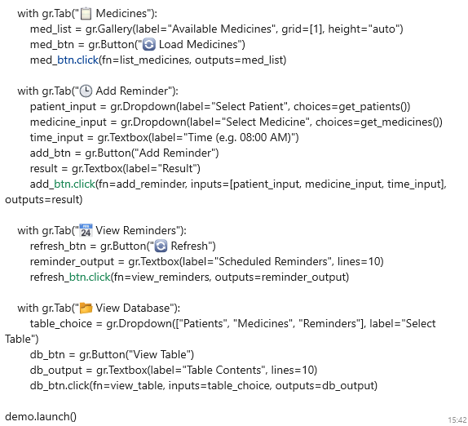
SOURCE CODE

Slide 10
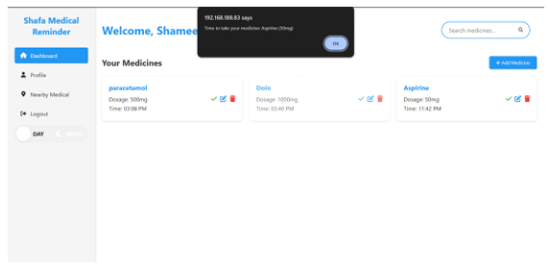
OUTPUT

Slide 11
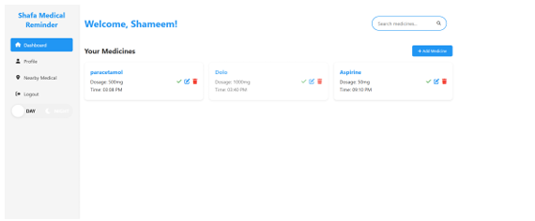
OUTPUT

Slide 12
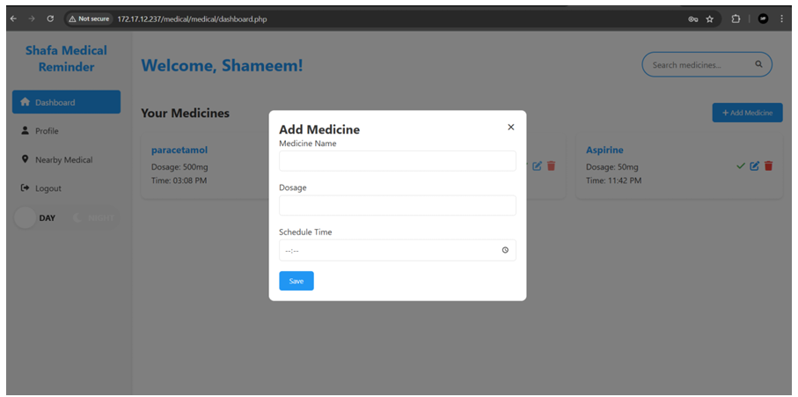
OUTPUT

Slide 13
CONCLUSION
The Medication Reminder System simplifies medication management, reducing health risks due to missed doses.
Future improvements, like AI-based reminders and wearable integrations, can enhance its effectiveness further.
The system can be expanded to support multiple users in a family or integrate with electronic health records (EHRs) for better healthcare tracking.
This system can be integrated with pharmacies and healthcare providers to enable prescription refills and doctor alerts.

Slide 14
THANK YOU

